Slide 1
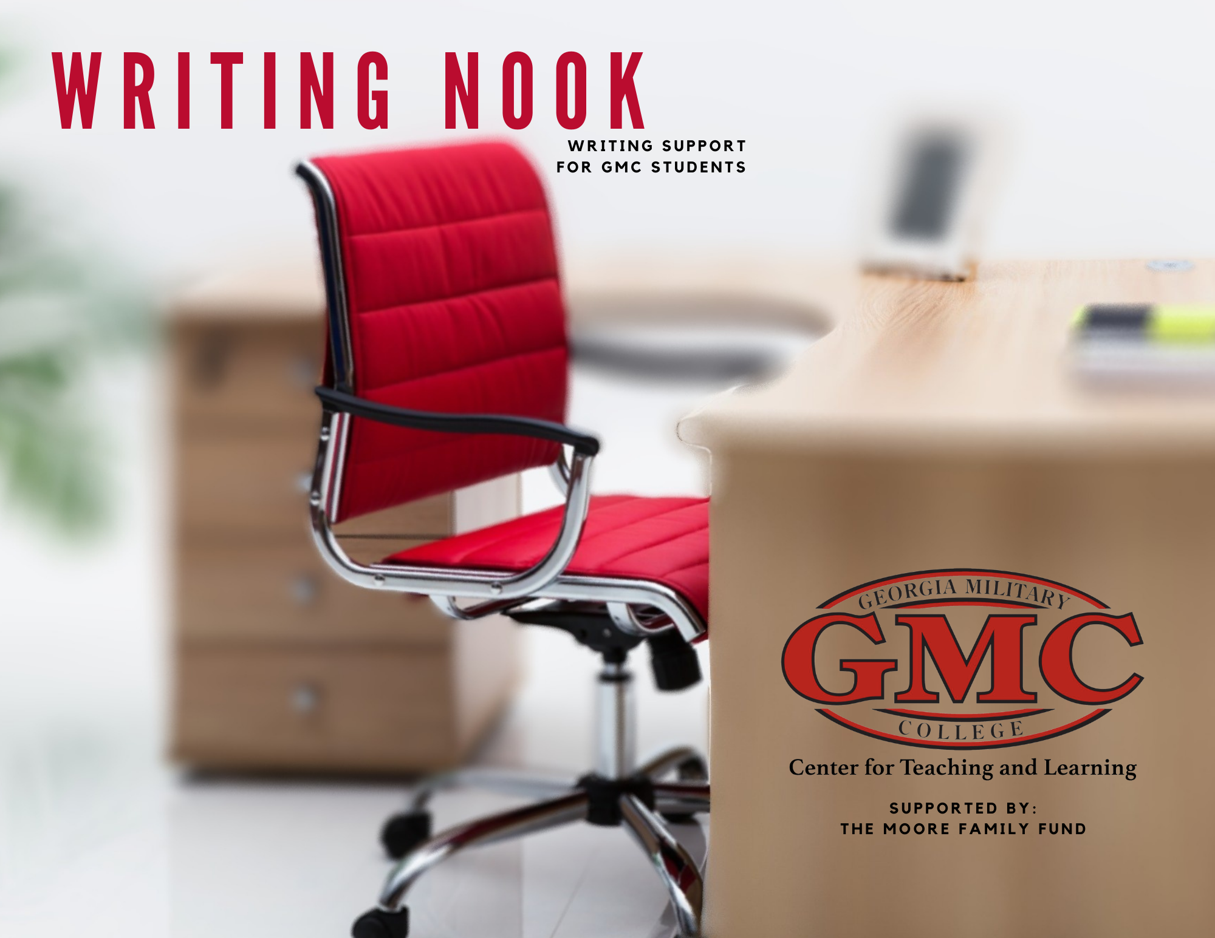

Slide 2
The Writing Process
Finishing The Essay You Have Started

Slide 3
Proofreading the First Draft
Proofreading -- examining your essay carefully to correct grammar, spelling, or structural mistakes.
After writing your essay, it’s time to proofread for common errors --
    Fragmented Sentence Errors -- Sentences that are incomplete or should be combined.
    Run-On Sentence Errors -- Two or more sentences that are incorrectly combined or missing punctuation.
    Comma Errors -- Missing or Extra commas that are not following the comma rules.
    Pronoun Agreement -- a pronoun must agree with its antecedent; for example: student/(s)he; students/they;
    Apostrophes -- contractions and possession should include appropriate apostrophes.
    Spelling -- Incorrect word use, misspelled names, and auto-corrected problems should be reviewed.
    Missing or Doubled Words -- the auto-correct will not catch a missing word or a word used twice in a row.
Taking time to proofread will help your overall essay grade!!

Slide 4
The Best Kept Proofreading Secret
Try reading your essay out loud.
One of the best ways to catch the errors in your essay is to read it out loud to yourself or someone else.
Yes, it will seem awkward at first, but think of all of the good grades!

Slide 5
A Checklist for the Final Draft
What are some questions to ask about your essay before you submit the final draft?
Do I have a clear thesis statement, topic sentences, and purpose which are all on one topic?
Are my ideas organized in a logical way, such as time order or least to most important?
Have I checked for errors in grammar, spelling, and word use?
Do my sentences and paragraphs flow together?
Have I given enough details so that my audience will understand what I have written?
Does my conclusion have a final thought or interesting ending?
Is the language and tone of my essay correct for my purpose?
Does the research, if needed, support the Thesis Statement? Do I have enough evidence?

Slide 6
Getting Over Writer’s Block
Writer’s Block -- Not knowing what to write next.
If you feel like you don’t know what to write next, try these solutions --
  Talk about your essay with another person or read it out loud to yourself.
  If you are typing, try printing out your essay and handwriting the rest for a while.
  Go for a walk, get a snack, take a shower, or listen to music for a few minutes.
  Set a timer, do other homework, and go back to writing later.
Most importantly, be patient with yourself and focus on the positive side. Talk to your teacher, and make an appointment with a tutor, as needed.

Slide 7
