Slide 1
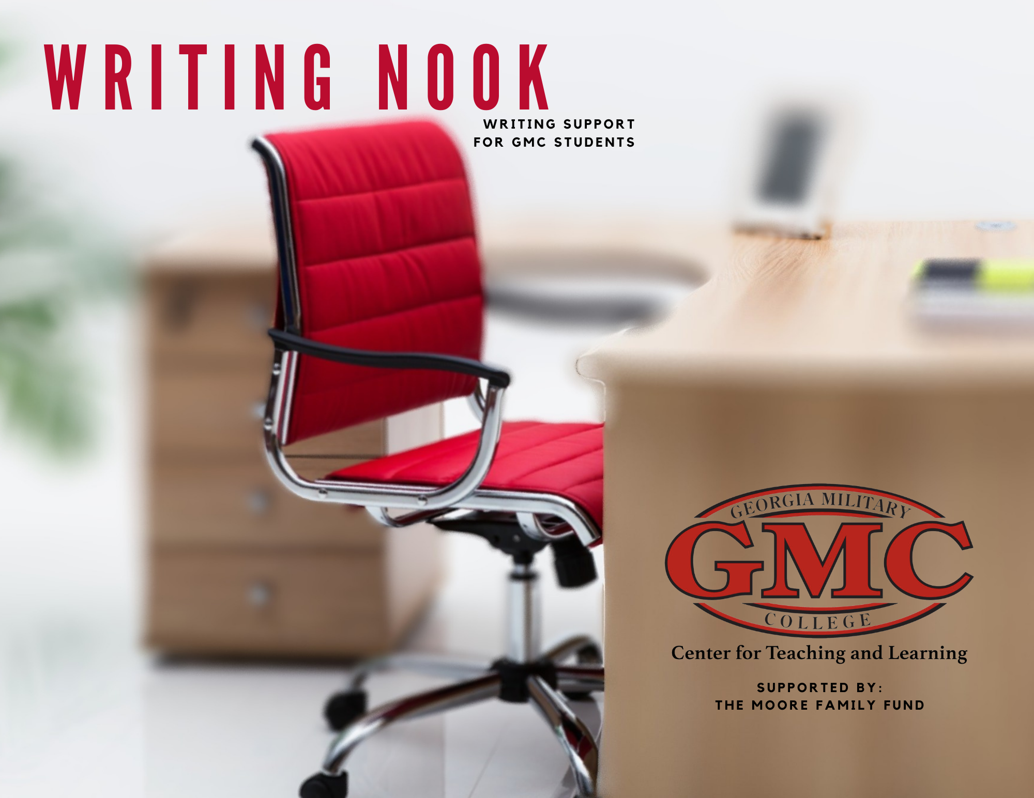

Slide 2
The Writing Process
The First Draft – Purpose, Editing, and Revising.

Slide 3
A Checklist – The Pieces of the Puzzle
If you can answer yes to these questions, you are ready to begin your first draft of your essay –
    Do you understand the directions for the assignment, including the deadline day and time?
    Have you written out your Thesis Statement?
    Have you completed your research, if needed?
    Do you have an Outline of your topic sentences and paragraph information?
If you answered no to any question, complete that task and come back to this page to begin the first draft.

Slide 4
As You Write, Remember Your Purpose
Purpose -- the reason why you are writing.
What is the purpose of your essay, such as describe, argue, define, explain?
  Remembering your purpose will help you choose the best words and details for your essay and will help keep you focused on your topic.
  Ask yourself questions related to your purpose, and answer them to give yourself ideas for the best words and examples in your writing.
      For example, with an argument essay –- What causes _____? What are the effects of _____?
      For example, with a process essay –- What do I mean by _____? What are some examples of _____?
      For example, with a narration essay –- What came before or after _____? When and where does ____ happen?
Your thesis, topic sentences, and conclusion should reflect your purpose.

Slide 5
Getting It Right, as You Write
Editing –- making sentence level corrections and changes.
How do you decide which words are effective and which should be edited?
    Use specific and powerful words to express your ideas about your topic.
    Combine short, choppy sentences into longer, more interesting sentences.
    Be clear in your writing, and avoid misunderstanding.
    Use active voice.
    Use a dictionary and a thesaurus as write the first draft.
You will save yourself time, if you edit for sentence level corrections as you go through your first draft.

Slide 6
Getting It Right, as You Write
Revising -- making major corrections and changes to the organization or content of an essay.
How do I know when I should revise?
    Plagiarism. Does your essay have incorrect citations and quotation marks?
    Major Grammar Errors. Do you have fragmented, run-on, and comma splice sentences?
    Paragraph Structure Problems. Do you have more than one idea per paragraph?
    Development Needed. Does your essay have very short paragraphs?
    Transitions Needed. Does each paragraph have words to signal the reader about ideas?
    Unity Needed. Do the topic sentences and conclusion reflect the Thesis Statement?
Revision is one of the final steps in The Writing Process, so be patient if you have to retype or rewrite an essay for a second or third draft.

Slide 7
