Slide 1
How to SEARCH Scholarly Databases Effectively
Navigating GMC Library to Locate Scholarly Databases and Articles

Slide 2
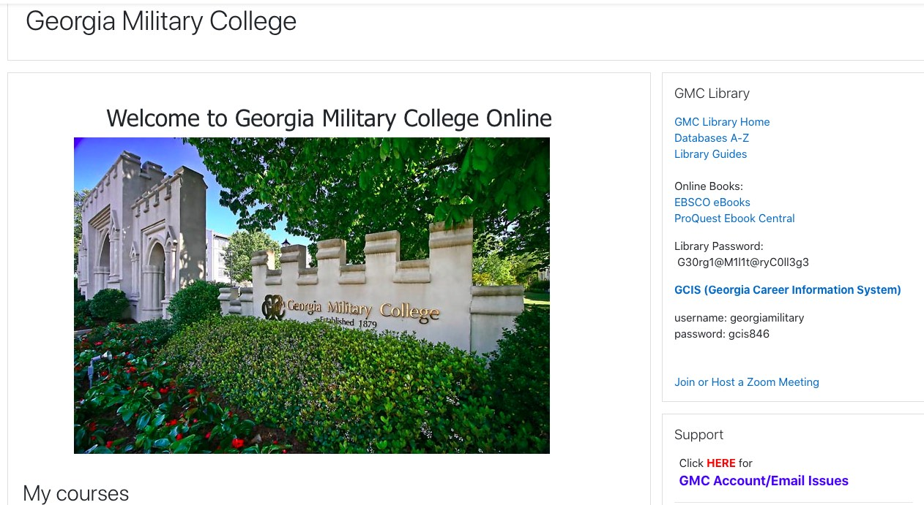
Access
On your Moodle homepage, find the GMC Library block on the right-hand side of the page (see arrow at right).

Slide 3
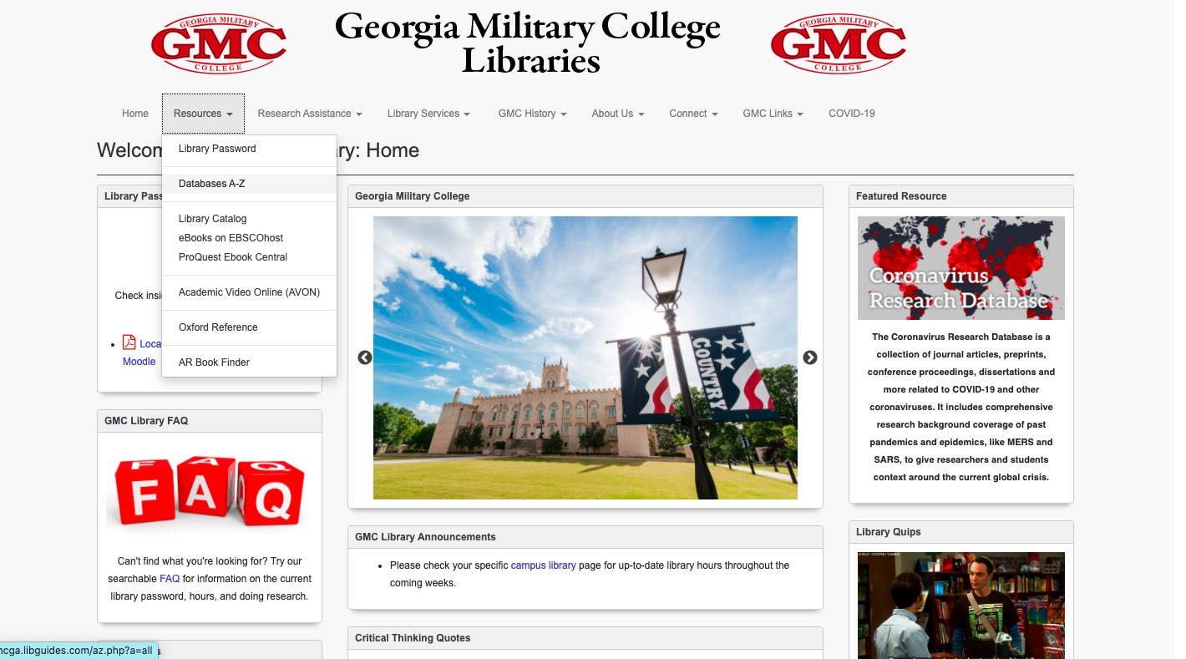
Choose “Databases A-Z” from the dropdown menu.
Choose “Databases A-Z” from the dropdown menu. (“Databases A-Z” is also linked on the main page within the GMC Library block).

Slide 4
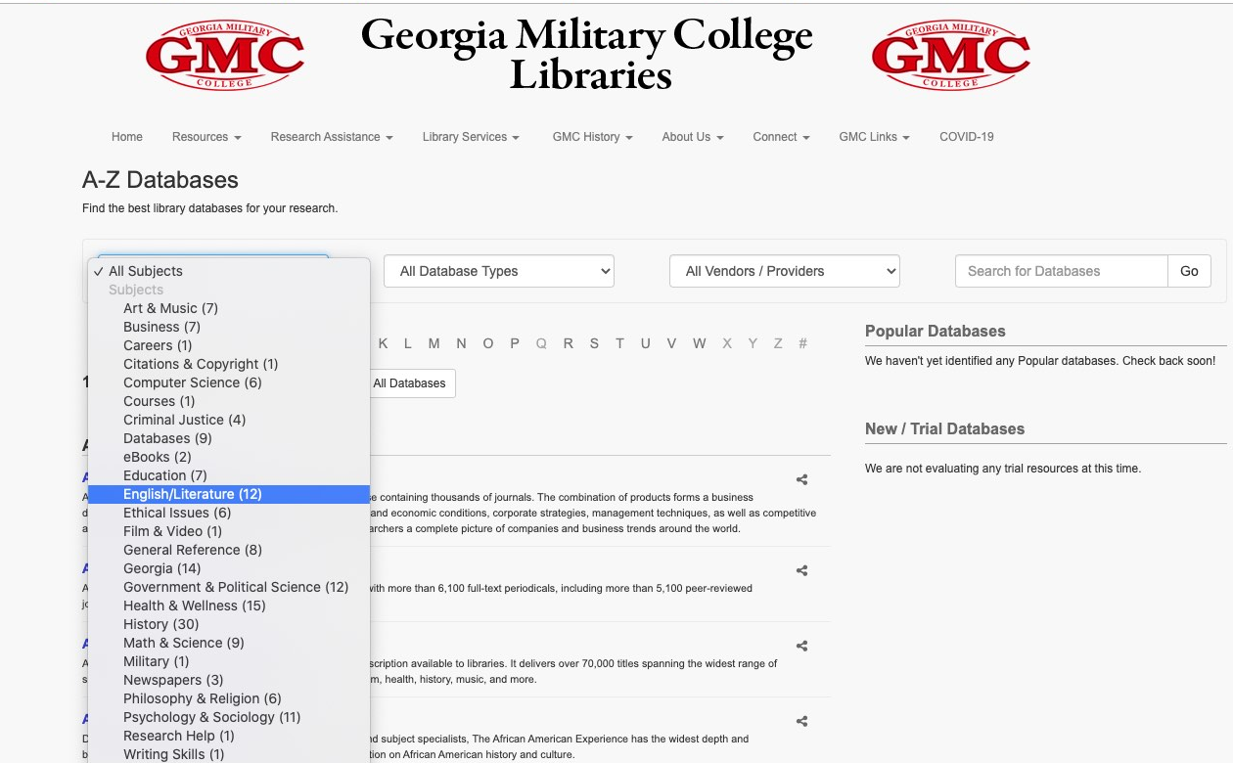
Look For Articles By SuBject VIA the “SUBjECTS” Drop-Down Menu (For Example, “English/
Literature” HIGHLIGHTED AT RIGHT) OR SEARCH FOR A SPECIFIC DATABASE BY Beginning LETTER. FoR EXAMPLE: “LITERARY REFERENCE CENTER” IS LiSTED UNDER LETTER “L”).

Slide 5
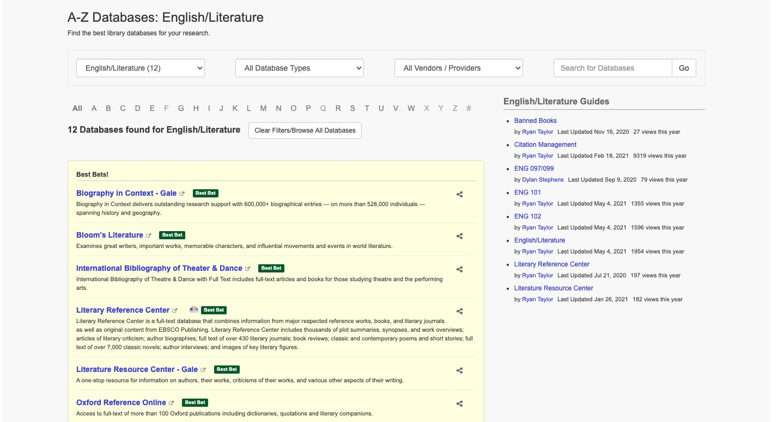
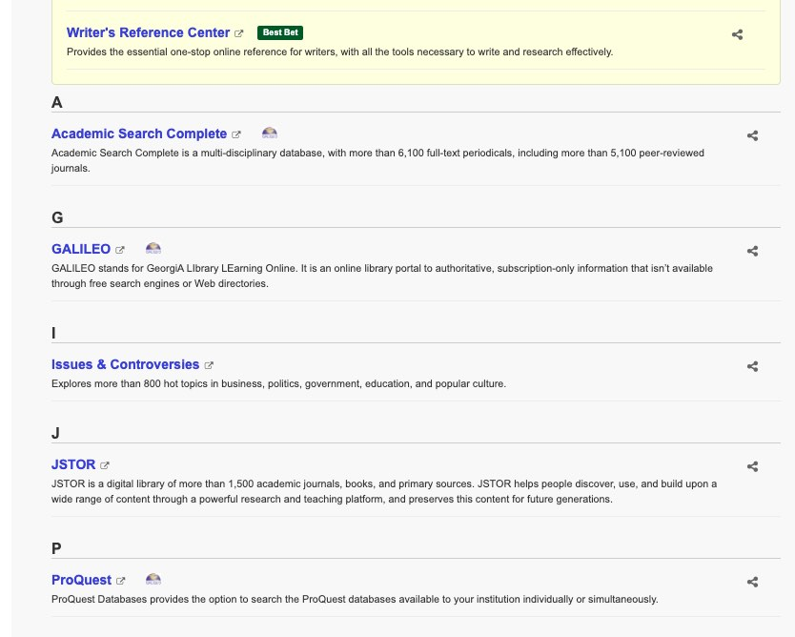
Database selection
For the sake of example, let’s continue to imagine that we are searching for sources related to an English literature class. Generally speaking, the best databases for English courses are Bloom’s Literature, Literary Reference Center, Literature Resource Center, JSTOR, and ProQuest. (But remember, for other subject areas, utilize the “Databases by Subject” feature mentioned on the previous slide, and contact a librarian or your professor for help if you’re still having trouble locating scholarly articles for that subject area)

Slide 6
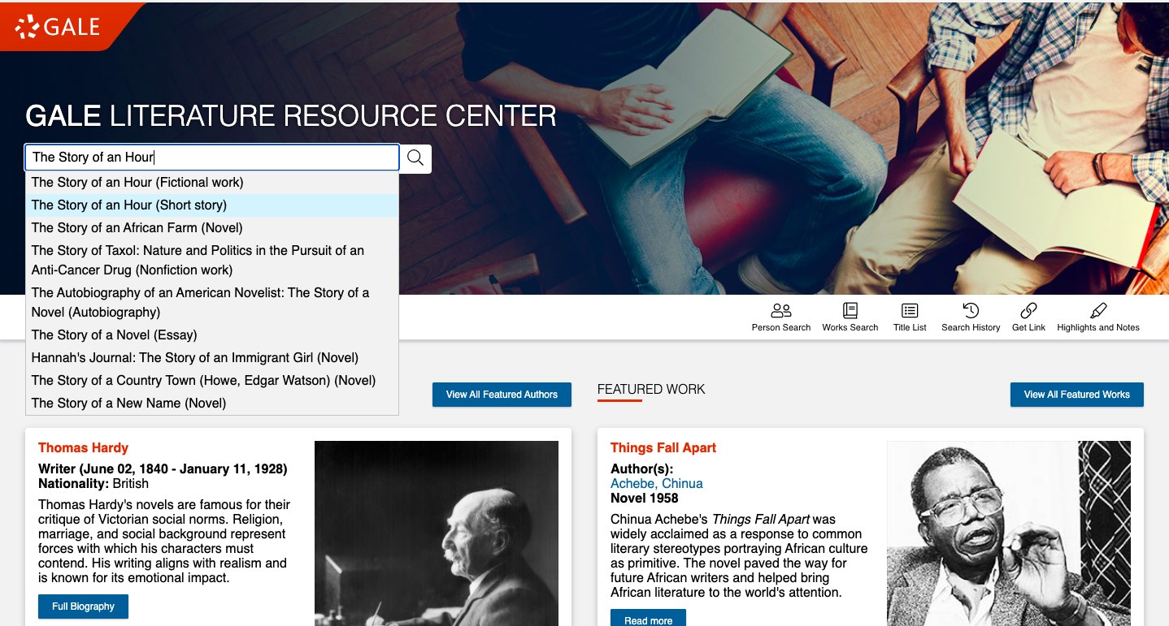
In this example, I’ve chosen “Literature Resource Center” and am now searching by story title- in this case, Kate Chopin’s “The Story of an Hour.”

Slide 7
Some tips to keep in mind as you search:
Again, using English as an example-- you want to locate opinionated articles with an argument about a specific aspect of the subject matter you’re researching, not simply plot summaries or general overviews of the story. However, keep in mind that the types of scholarly sources you want can vary by subject/instructor.
If you can’t find a useful article in one database, try another.
Most databases allow you to search specifically for full-text articles (instead of just abstracts or excerpts) and specifically for literary criticism (rather than biographies or summaries) via advanced search or limiting options

Slide 8
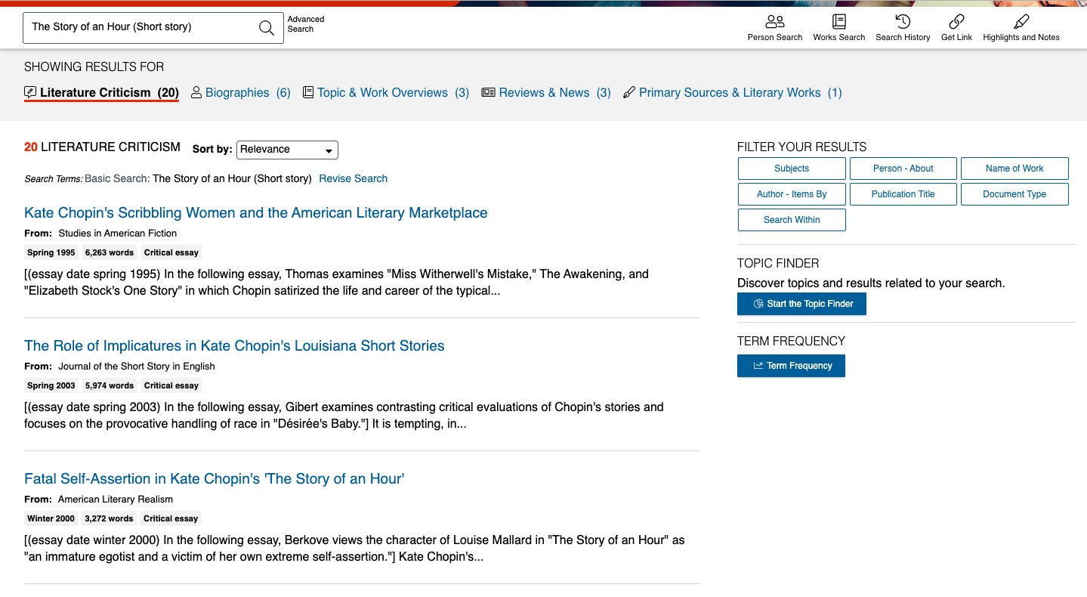
The first page of search results at left shows several articles. The best choice from these first three options is probably the third one because it is the only one of the three that seems to be most relevant to “The Story of an Hour,” according to the summary text under the title. However, you may need to open and skim several articles to best determine a source’s usefulness.
**Note that the results are limited to “Literature Criticism,” which is a helpful tool to avoid some articles that aren’t as relevant to your search.**

Slide 9
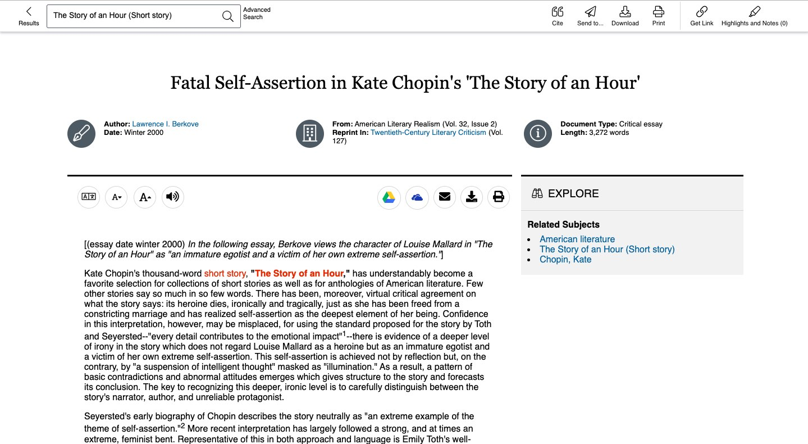
The article as it appears once selected.

Slide 10
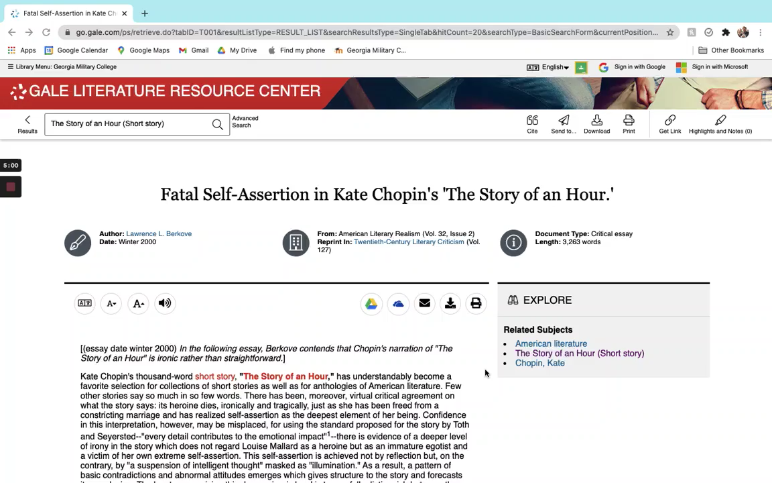
This video shows a scroll-through of our chosen article from Literature Resource Center with the citation at the bottom of the page. (Click image at right, then ‘play’ icon underneath)
Notes:
Video has no audio

Slide 11
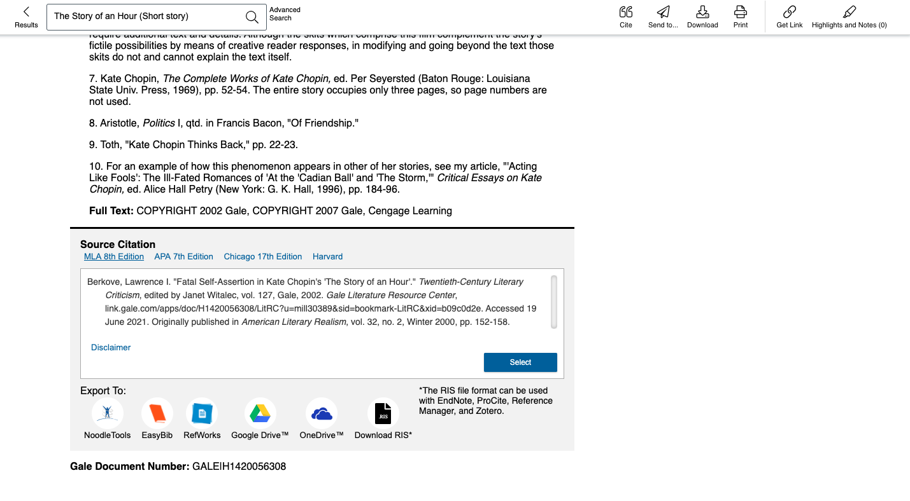
As seen below, the Literature Resource Center database provides the source citation for your works cited page (as do many other databases). The location varies by database, but keep in mind that many of these databases will provide the works cited entry for you if you locate and click a button somewhere on the page entitled “Citation,” “Cite,” “Source Citation” etc.
**Note that you can also choose what particular format to use for the citation. Since we were research for English in this example, we chose MLA Style, but remember that many other subjects require APA style. The citation you need will be provided based on what style you select.

