Slide 1
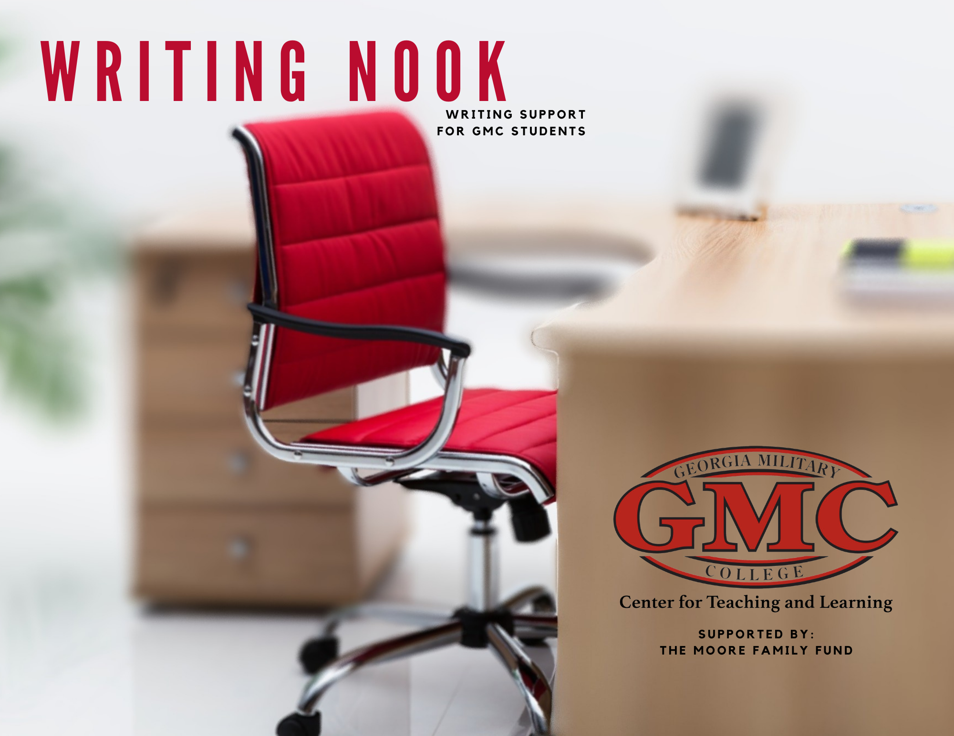

Slide 2

Moving to Academic Voice
Prof. Randall Bonser
GMC Composition/Creative Writing

Slide 3

But I talk pretty gooder already…
Nothing wrong with the way you talk! But …
Academic Voice opens up a world of readers
Vernacular

Slide 4

Like Learning a New Language
Moving to a new “voice” takes time and practice.
Don’t expect to master it at once.
Academic Voice will open doors in college and business.

Slide 5
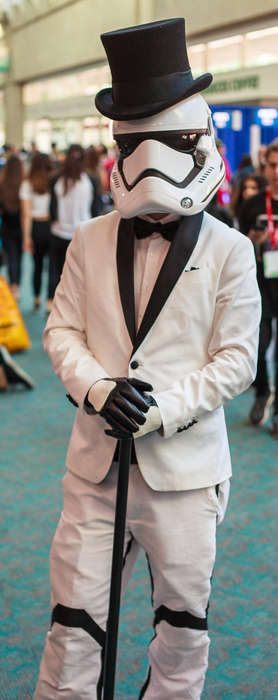
Moving to Academic Voice asks us to…
Move from informal to formal language.
Avoid conversational constructions like, “Well,” “Come on, now,” and “There’s no way.”
Avoid questions to the reader like, “What do you think?” and “Why do we do that?”
Spell out contractions like “is not” instead of “isn’t.”
While humor is appropriate for certain types of essays such as personal narratives, academic voice is more serious.
This Photo by Unknown Author is licensed under CC BY-NC-ND

Slide 6

Moving to Academic Voice asks us to…
Move from opinions to supportable arguments.
Avoid phrases like “In my opinion…”
Use declarative sentences by removing “I”, as in “The death penalty should be abolished because…”
Always support your assertions with evidence.
Always cite where your evidence and ideas come from with proper MLA citations.
Share your ideas and conclusions sparingly, and only based on evidence you have presented.

Slide 7
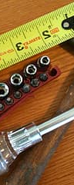
Moving to Academic Voice asks us to…
Move from vague to precise language.
Give specific quantities; instead of “a few states have laws…” write “five states have laws…”
Avoid the use of vague superlatives like “very,” “many,” “a lot,” and “so.”
In MLA format, spell out numbers comprised of three words or less; instead of 56%, write fifty-six percent.
Be specific, especially in thesis statements.

Slide 8

Moving to Academic Voice asks us to…
Move from wordiness to concise sentences.
Get rid of unnecessary phrases; instead of “due to the fact that,” write “because.”
Trim down sentences to the fewest possible words.
Edit out redundancies, and don’t say the same thing in different places (you see what I did there?). Redundancy is usually the result of artificially boosting word totals (often a result of not enough research), and it hurts your credibility.

Slide 9

Moving to Academic Voice asks us to…
Move from passive to active voice.
Stay away from passive constructions, which muddle the sentence: “Research was conducted by the University of Tyrone that proves that Bigfoot is real.”
Write active sentences with strong subjects: “The University of Tyrone conducted research that proves Bigfoot is real.”
This Photo by Unknown Author is licensed under CC BY-NC-ND

Slide 10
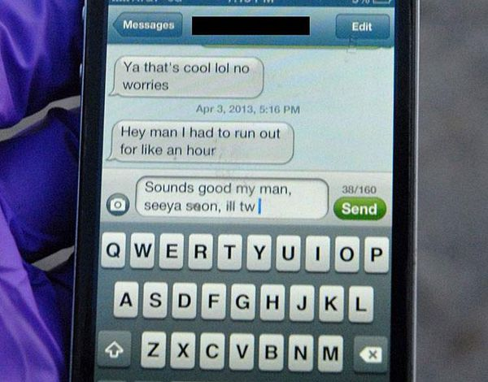
Moving to Academic Voice asks us to…
Move from DM-minimalism to correct punctuation.
Do not sabotage your argument’s power by making it difficult to read – the minimalist punctuation of direct messages and texting is not sufficient for the complex discussions in academic writing.
Learn how to spot and fix run-on sentences and fragments.
Remember that laptops do not auto-correct wrong punctuation like smart phones; however, pay attention to the “mistake” cues.
Learn to use transitional words or phrases to signal how your argument is progressing. Are you: changing topics? Developing a point? Refuting a counterargument?
This Photo by Unknown Author is licensed under CC BY-SA

Slide 11

Moving to Academic Voice asks us to…
Move from insulting speech to respectful discourse
While including opposing viewpoints is an effective rhetorical tactic, avoid belittling the opposition.
Avoid the popular fallacy of a false dichotomy; admit when your opponent makes a good point.
Signal when you are including a counterargument with phrases such as “Opponents argue that…”

Slide 12

Moving to Academic Voice asks us to…
Move from spontaneity to structure.
While creative writing forms are enjoyable, academic writing is more structured and is created with a rhetorical purpose.
Even within structured forms, however, writers can often inject some creativity to make the essay more enjoyable to read; just remember the purpose of the essay as laid out in the instructions.
This Photo by Unknown Author is licensed under CC BY-SA

Slide 13

Expand your audience
Master Academic Voice to let the world hear your brilliant ideas!

Slide 14
